Slide 1
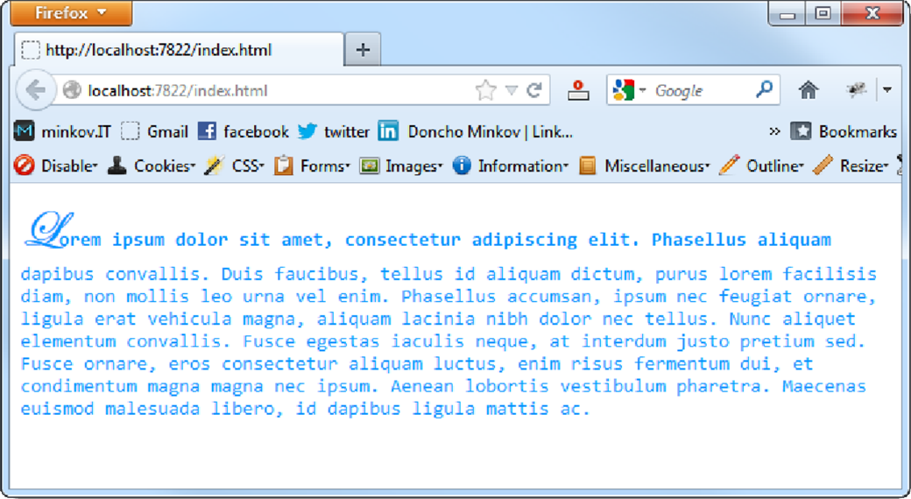
Homework
Create the following web page
Fonts used: Consolas, Edwardian Script ITC
Color: #0094ff

Slide 2
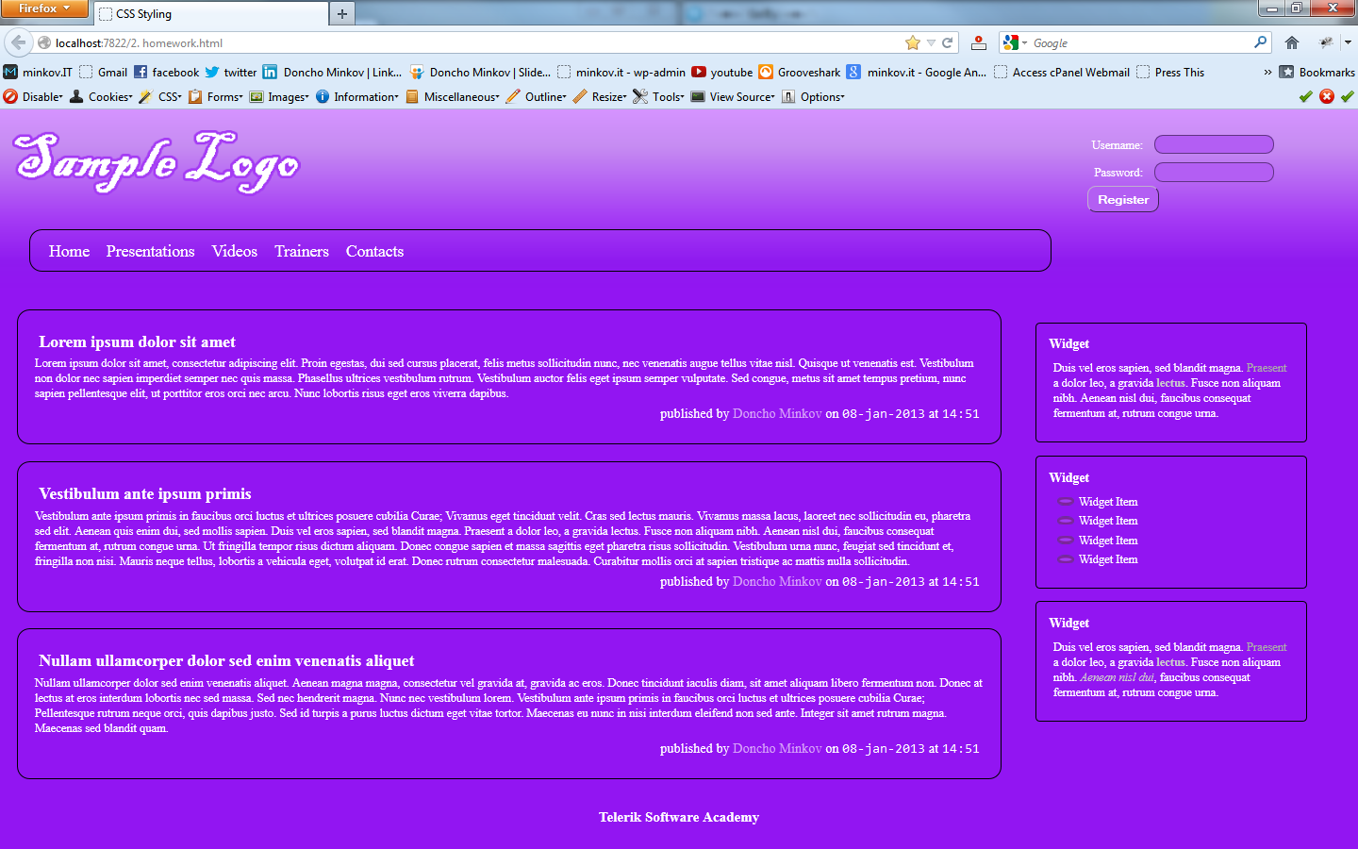
Homework (2)
You are given prewritten HTML and CSS code. Expand this code to make the web page to look exactly like the PNG image:
You can find the files in 2. Homework.zip

Slide 3
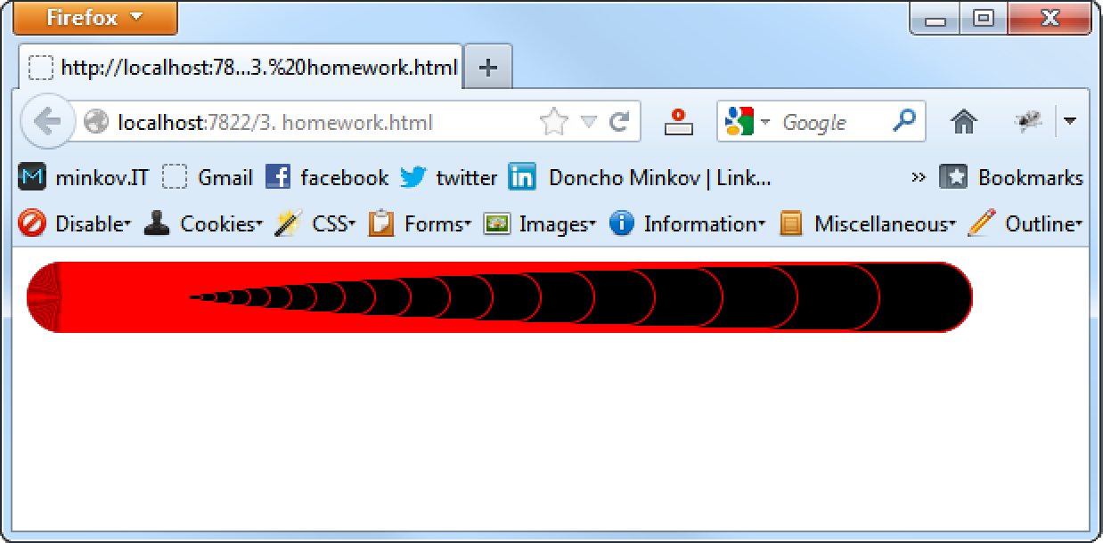
Homework (3)
Create the following web page
Using 60 nested div elements

Slide 4
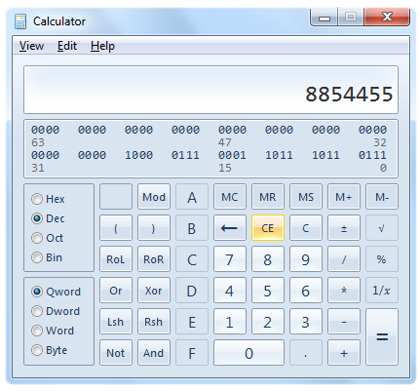
Homework (4)
Create a web page that looks like the Windows calculator in Programmer view
It should look exactly the same
Implement hover effects for the buttons
The calculator should not have any functionality

